Slide 1
Confidence Intervals
Part 3.2 Confidence Intervals and Hypothesis Testing
Be very careful!!!

Slide 2
But how do we learn about the population?
Sampling
Population
Sample
Guess about population
(e.g., summary statistics)
Inference
Info about sample
(e.g., summary statistics)

Slide 3
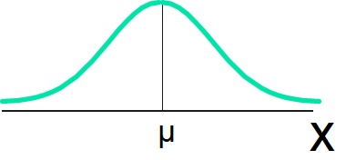
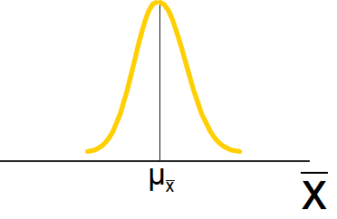


If Population Mean is Unknown
Population Distribution
= ?
Mean of $\overline{X}$ →$μ$
Sample Mean Distribution
Suppose can take
ALL samples of size n
Notes:
A measure of the variability in the mean from sample to sample is given by

Slide 4

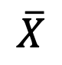




If Population Mean is Unknown
Only one sample is available.
But we need to estimate the population parameter somehow.
Ask instead: how far is the population mean from the observed sample mean?
$$\overline{X}$$
$$μ_{}$$
$$μ_{}$$
$$μ_{}$$
$$μ_{}$$
$$μ_{}$$
$$μ_{}$$
$$μ_{}$$
$$μ_{}$$
$$μ_{}$$
Notes:
A measure of the variability in the mean from sample to sample is given by

Slide 5
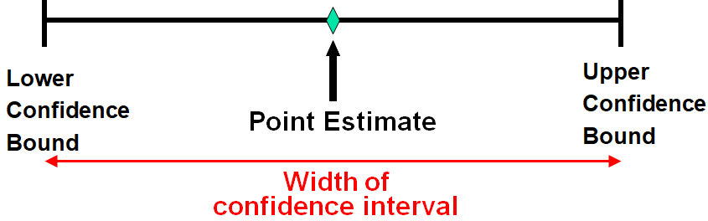
Point Estimates vs Interval Estimates
Point estimate: a single number
This is the estimation we have done so far
Interval estimate: an interval to provide additional info on the variability of the estimate.
How precise is it (width of the interval)?
How confident you are (chances the interval is “correct”)?
Notes:
A point estimate is a single number,
a confidence interval provides additional information about the variability of the estimate

Slide 6
Example 5 (from last time): Vending Machine
… X$is NOT normally distributed and we do not know the distribution.$
For a period of 144 days, daily observations have been conducted about the number of candy bars sold from a vending machine. Using these observations:
Mean of the sample = 258
Standard deviation of the sample = 60
Q. For a 144-day period, find:
P(average number of candy bars sold > 263) =
Notes:
Is calculated to be equal to

Slide 7
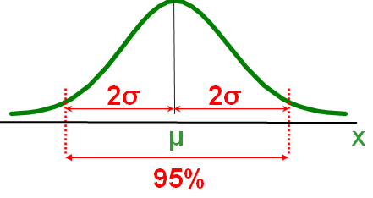

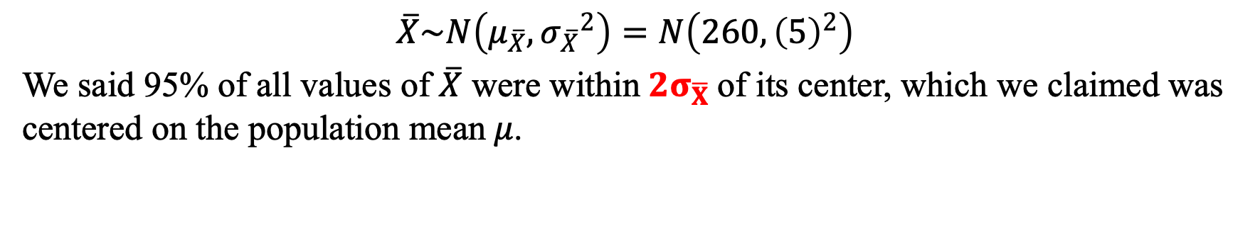
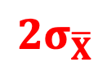
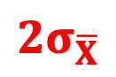


Example 5 (from last time): Vending Machine
… X$is NOT normally distributed and we do not know the distribution.$
$$\overline{X}\sim N\left(μ_{\overline{X}},{σ_{\overline{X}}}^{2}\right)=N\left(260,{\left(5\right)}^{2}\right)$$
We said 95% of all values of $\overline{X}$ were within${2σ}_{\overline{X}}$of its center, which we claimed was centered on the population mean$μ$.
$95\%=P\left(μ−{2σ}_{\overline{X}}<\overline{X}<μ+{2σ}_{\overline{X}}\right)$
$${2σ}_{\overline{X}}$$
$${2σ}_{\overline{X}}$$
$$\overline{X}$$
$$μ$$
$$\overline{X}$$
95%
Notes:
Is calculated to be equal to

Slide 8
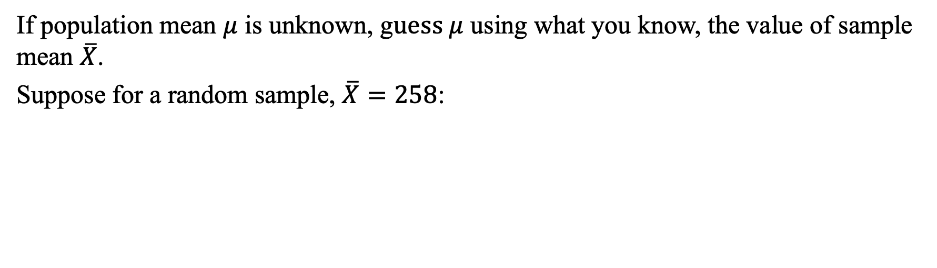
Example 5 (from last time): Vending Machine
… X$is NOT normally distributed and we do not know the distribution.$
If population mean $μ$ is unknown, g$uess μ$ using what you know, the value of sample mean $\overline{X}$.
Suppose for a random sample, $\overline{X}=258$:
$95\%=P\left(μ−{2σ}_{\overline{X}}<\overline{X}<μ+{2σ}_{\overline{X}}\right)$ = $P\left(248<\overline{X}<268\right)$
$${2σ}_{\overline{X}}$$
$${2σ}_{\overline{X}}$$
$$\overline{X}$$
$$μ$$
$$\overline{X}$$
95%
Notes:
Is calculated to be equal to

Slide 9
Example 5 (from last time): Vending Machine
… X$is NOT normally distributed and we do not know the distribution.$
If population mean $μ$ is unknown, g$uess μ$ using what you know, the value of sample mean $\overline{X}$.
Suppose for a random sample, $\overline{X}=258$:
$95\%=P\left(258−2×5<\overline{X}<258+2×5\right)$ = $P\left(248<\overline{X}<268\right)$
$${2σ}_{\overline{X}}$$
$${2σ}_{\overline{X}}$$
$$\overline{X}$$
$$μ$$
$$\overline{X}$$
95%
Notes:
Is calculated to be equal to

Slide 10
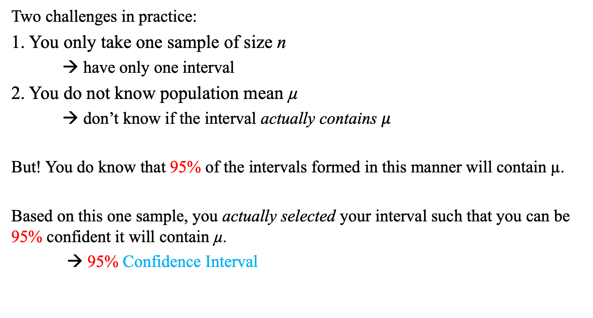

Is This Interval a Good Guess of $μ?$
Two challenges in practice:
1. You only take one sample of size n
→ have only one interval
2. You do not know population mean µ
→ don’t know if the interval actually contains $μ$
But! You do know that 95% of the intervals formed in this manner will contain µ.
Based on this one sample, you actually selected your interval such that you can be 95% confident it will contain µ.
→ 95% Confidence Interval
Notes:
Is calculated to be equal to

Slide 11


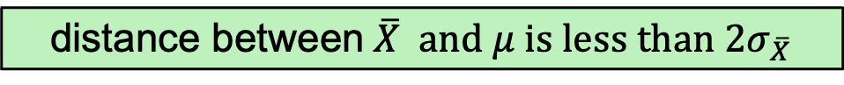

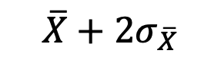
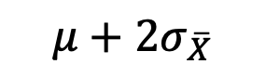

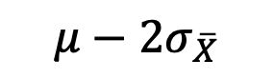
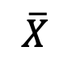
The Center Point Has Changed
Sampling
$$\overline{X}$$
$$μ−2σ_{\overline{X}}$$
$$μ+2σ_{\overline{X}}$$
$$μ$$
distance between$\overline{X} and μ is less than 2σ_{\overline{X}}$
Inference
$$μ$$
$$\overline{X}−2σ_{\overline{X}}$$
$$\overline{X}+2σ_{\overline{X}}$$
$$\overline{X}$$
Notes:
If player 1 doesn’t have any dominated strategy, start with the other player

Slide 12
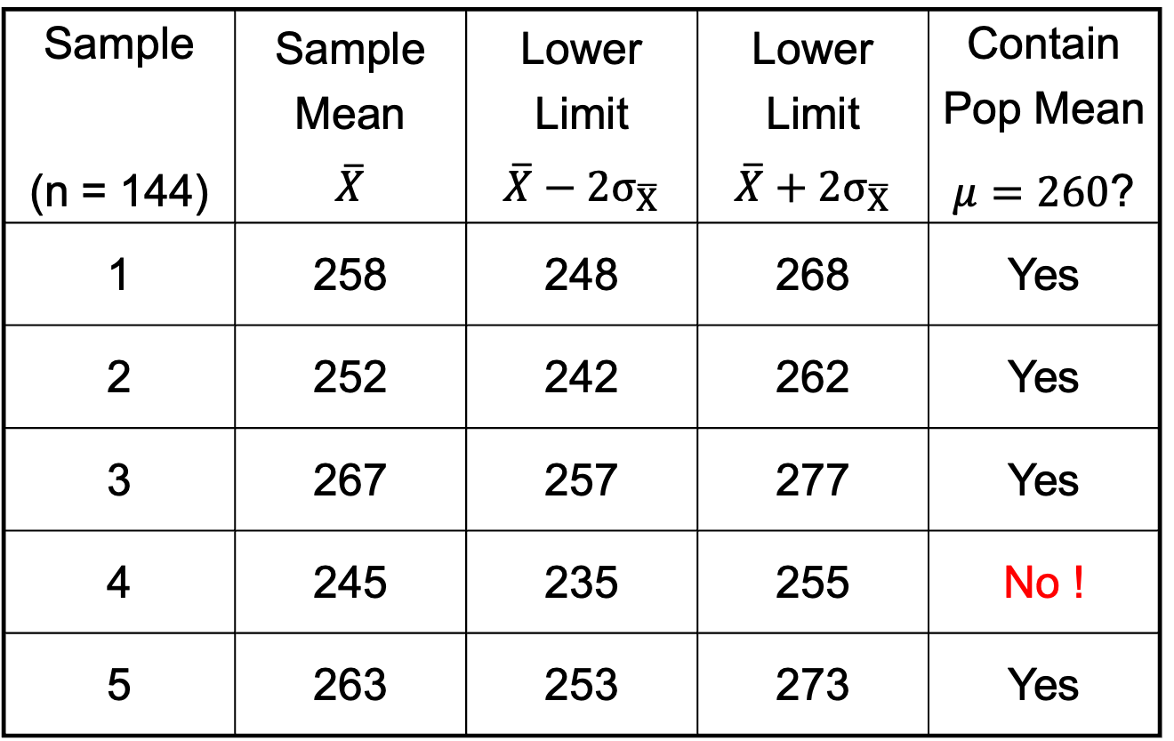
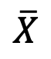
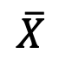
Is This Interval a Good Guess of $μ?$
Sample Mean (n = 144) | Sample Mean $$\overline{X}$$ | Lower Limit $$\overline{X}−{2σ}_{\overline{X}}$$ | Lower Limit $$\overline{X}+{2σ}_{\overline{X}}$$ | Contain Pop Mean $μ=260$?
1 | 258 | 248 | 268 | Yes
2 | 252 | 242 | 262 | Yes
3 | 267 | 257 | 277 | Yes
4 | 245 | 235 | 255 | No !
5 | 263 | 253 | 273 | Yes
$$\overline{X}$$
$$\overline{X}$$
$$\overline{X}$$
Notes:
Is calculated to be equal to

Slide 13
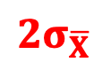
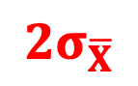
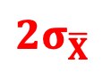



Is This Interval a Good Guess of $μ?$
$${2σ}_{\overline{X}}$$
$${2σ}_{\overline{X}}$$
$${2σ}_{\overline{X}}$$
= 10
= 10
$$\overline{X}$$
250
$$μ=260$$
270
$$\overline{X}$$
X₁ = 258
248
268
X₂ = 252
242
262
X₃ = 267
257
277
235
X₄ = 245
255
X₅ = 263
253
273

Slide 14
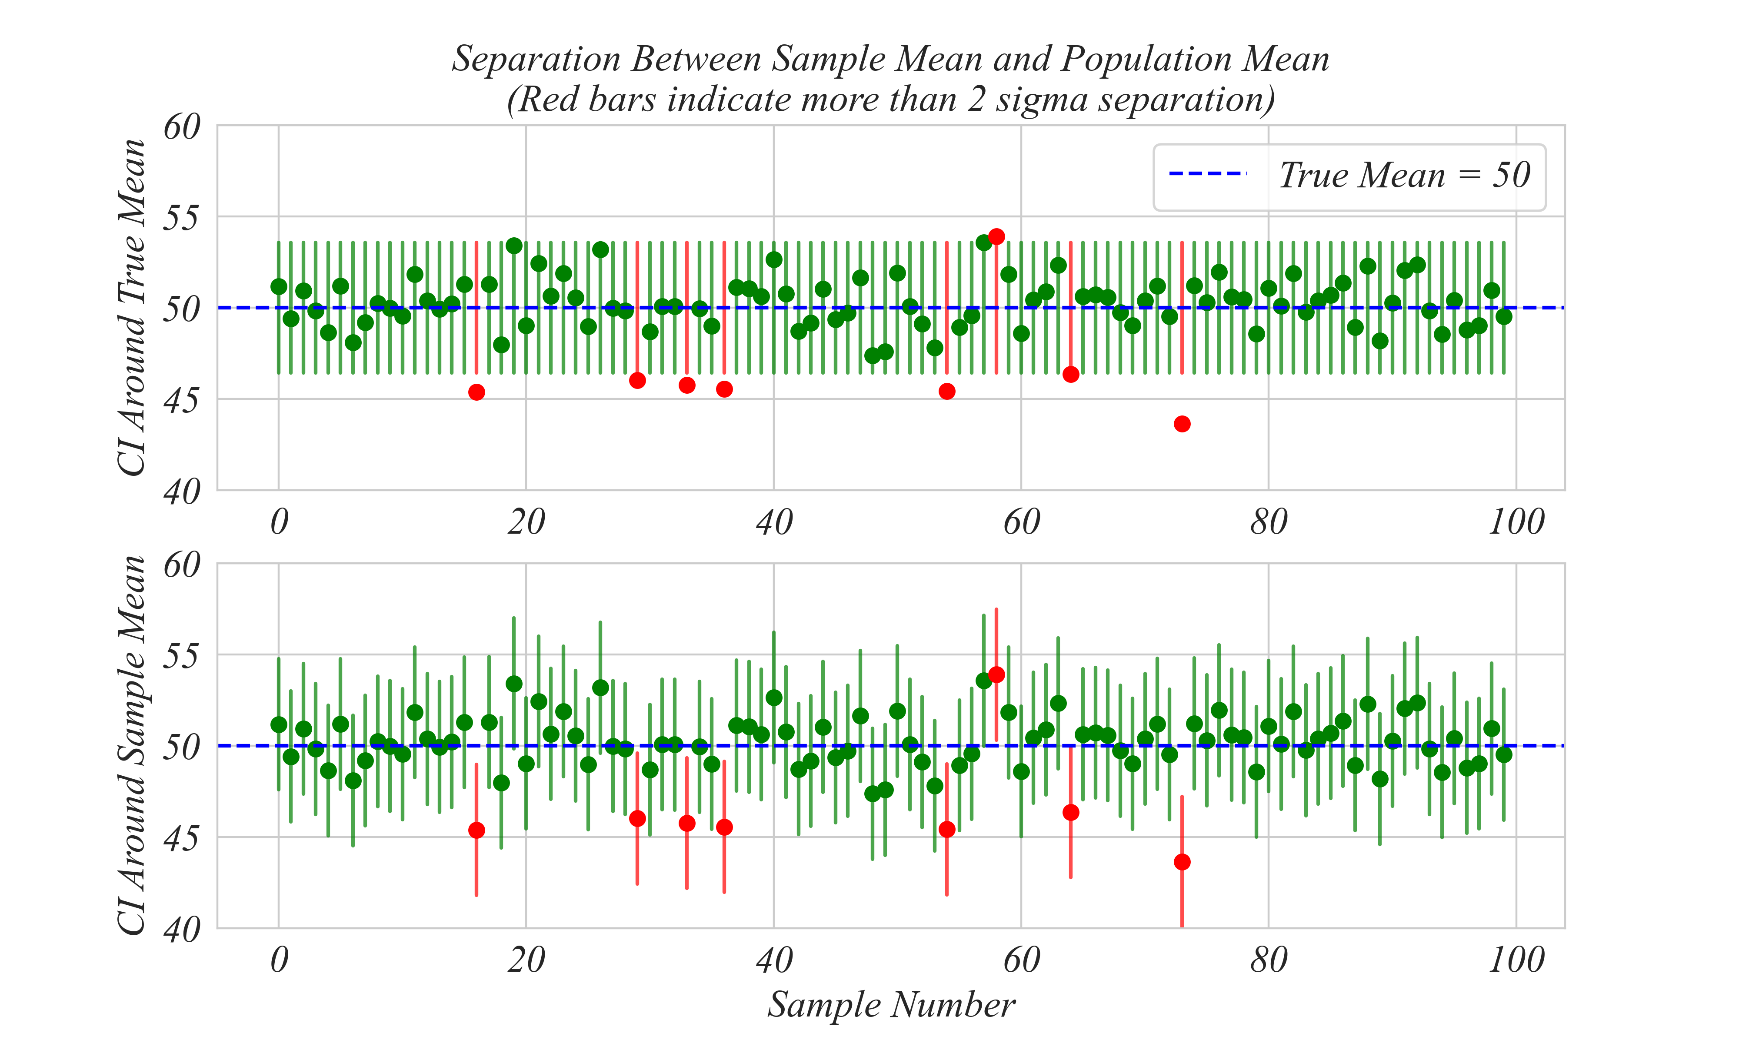
The Center Point Has Changed

Slide 15
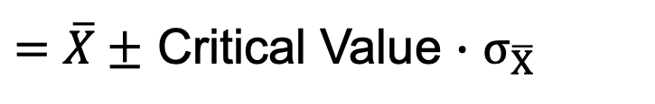
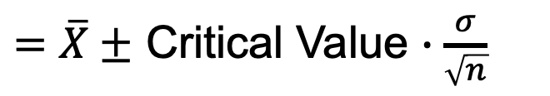
Estimating the Population Mean
Interval Estimate
$=\overline{X}±$ Critical Value $∙$ $σ_{\overline{X}}$
$=\overline{X}±$ Critical Value $∙\frac{σ}{\sqrt{n}}$
Point Estimate
Margin of Error
Critical Value: = 1 if looking for 68% confidence interval
= 2 if looking for 95% confidence interval
= 3 if looking for 99.7% confidence interval
Notes:
Under varying conditions:

Slide 16
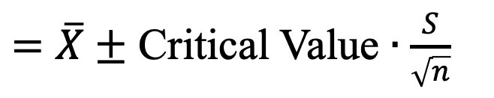
Estimating the Population Mean
Interval Estimate
$=\overline{X}±$ Critical Value $∙\frac{S}{\sqrt{n}}$
Notes:
Under varying conditions:
Write down the four items on the board:
(1) X_bar = ?
(2) S = ?
(3) N = ?
(4) critical value = ?

Slide 17
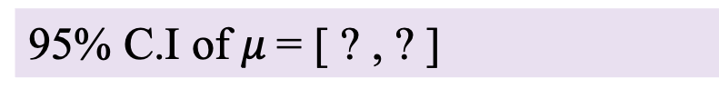
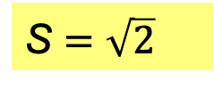
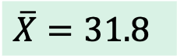
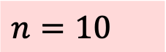
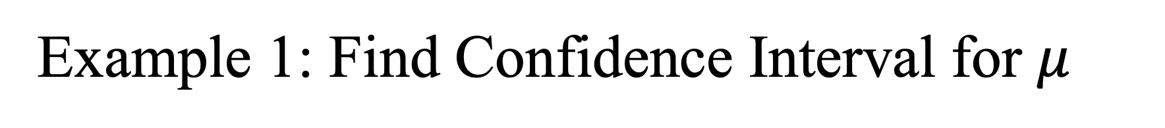
Example 1: Find Confidence Interval for $μ$
Working at Avis, you oversee buying mid-size cars and are considering proposals from Ford, GM and Chrysler (each offering one car model). Your key consideration: miles per gallon (mpg). You test drive 10 Ford vehicles:
Sample mean of mpg: 31.8
Sample variance of mpg: 2
Q. Based on this sample, what is the 95% confidence interval for the average mpg for a Ford fleet.
$$n=10$$
$$\overline{X}=31.8$$
S $=\sqrt{2}$
S $=\sqrt{2}$
95% C.I of $μ$= [ ? , ? ]
Notes:
Under varying conditions:

Slide 18

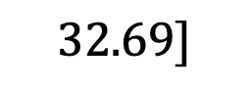

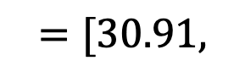
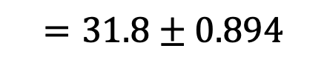
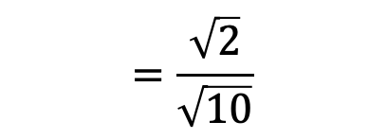
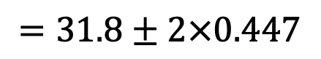

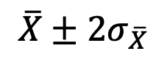
Example 1: Find Confidence Interval for $μ$
Working at Avis, you oversee buying mid-size cars and are considering proposals from Ford, GM and Chrysler (each offering one car model). Your key consideration: miles per gallon (mpg). You test drive 10 Ford vehicles:
Sample mean of mpg: 31.8
Sample variance of mpg: 2
Q. Based on this sample, what is the 95% confidence interval for the average mpg for a Ford fleet.
Is the distribution (X) normal? Yes.
$$n=10$$
$$\overline{X}=31.8$$
S $=\sqrt{2}$
S $=\sqrt{2}$
95% C.I
$$\overline{X}±2σ_{\overline{X}}$$
$$=31.8±2×0.447$$
$$=\frac{\sqrt{2}}{\sqrt{10}}$$
$$≈\frac{S}{\sqrt{n}}$$
$$σ_{\overline{X}}=\frac{σ}{\sqrt{n}}$$
$$=31.8±0.894$$
$$=0.447$$
$$=[30.91,$$
$$32.69]$$
Notes:
Under varying conditions:

Slide 19

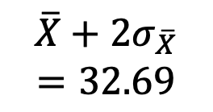

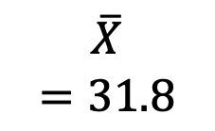
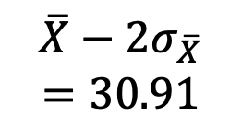
What Does $\overline{X}$ Suggest About $μ$?
$$μ$$
$$\overline{X}−2σ_{\overline{X}}$$
$$=30.91$$
$$\overline{X}$$
$$=31.8$$
$$\overline{X}+2σ_{\overline{X}}$$
$$=32.69$$
Notes:
Transition to the next slide:
Why?
Because the benchmark has changed

Slide 20
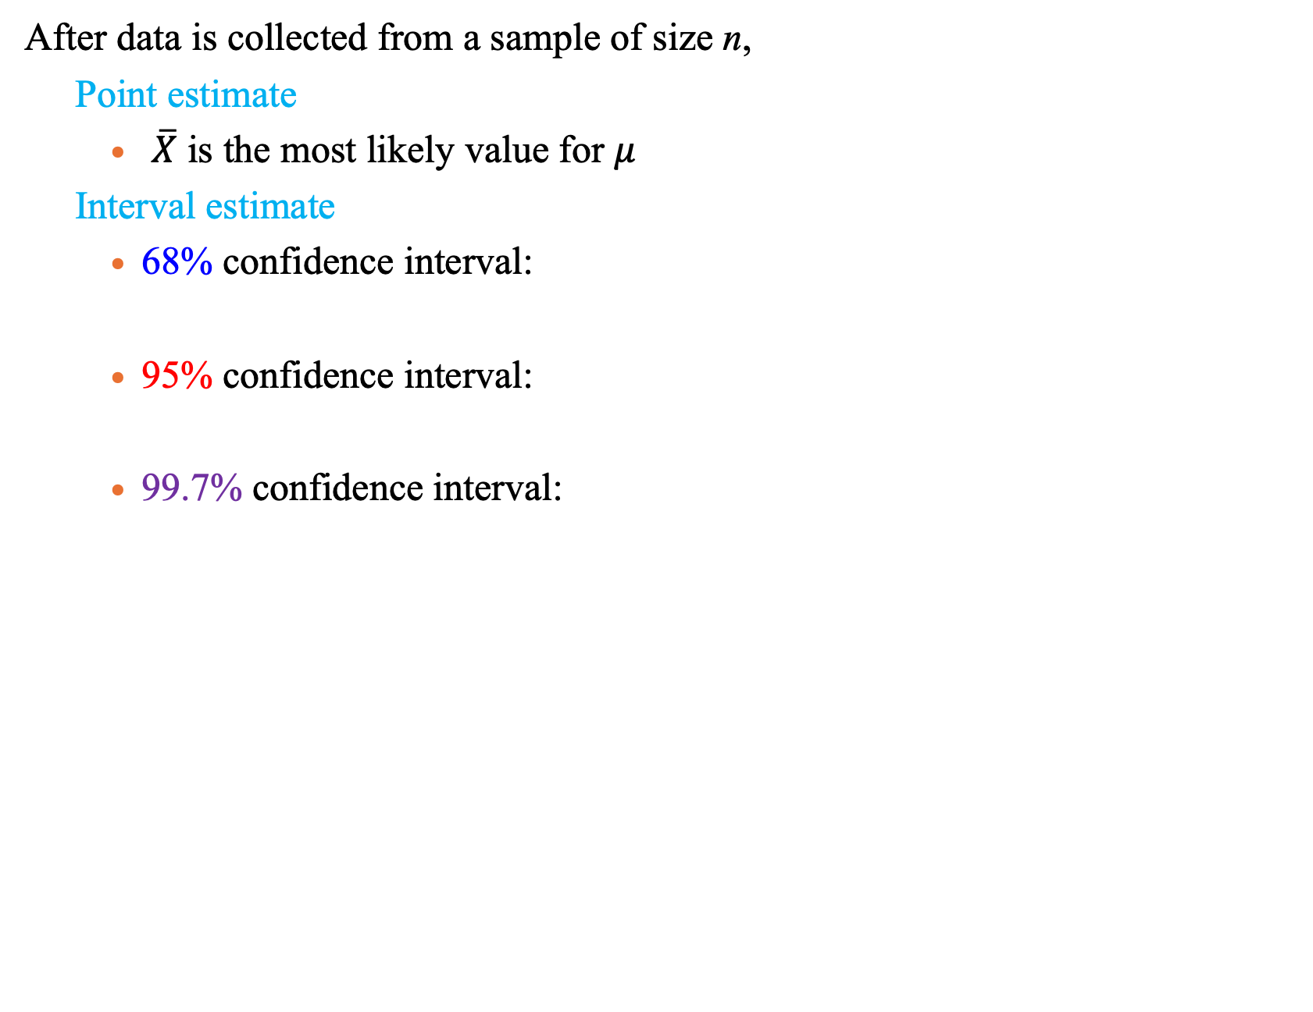
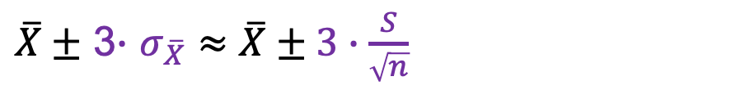
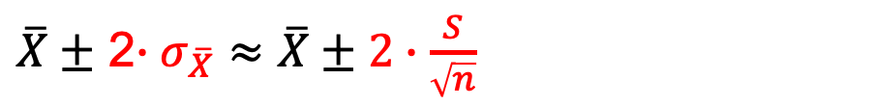
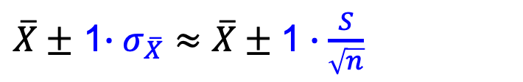
Estimating the population mean
After data is collected from a sample of size n,
Point estimate
$\overline{X}$ is the most likely value for $μ$
Interval estimate
68% confidence interval:
95% confidence interval:
99.7% confidence interval:
$\overline{X}±$ 1$∙σ_{\overline{X}}≈\overline{X}±\text{1}∙\frac{S}{\sqrt{n}}$
$\overline{X}±$ 2$∙σ_{\overline{X}}≈\overline{X}±2∙\frac{S}{\sqrt{n}}$
$\overline{X}±$ 3$∙$ $σ_{\overline{X}}≈\overline{X}±3∙\frac{S}{\sqrt{n}}$
Notes:
Under varying conditions:

Slide 21
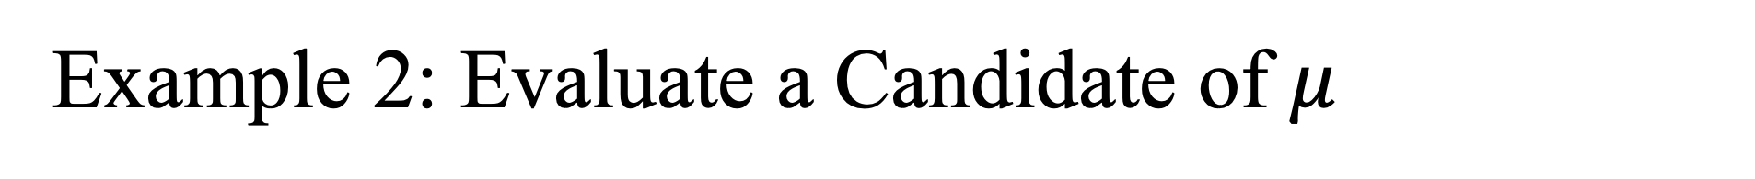
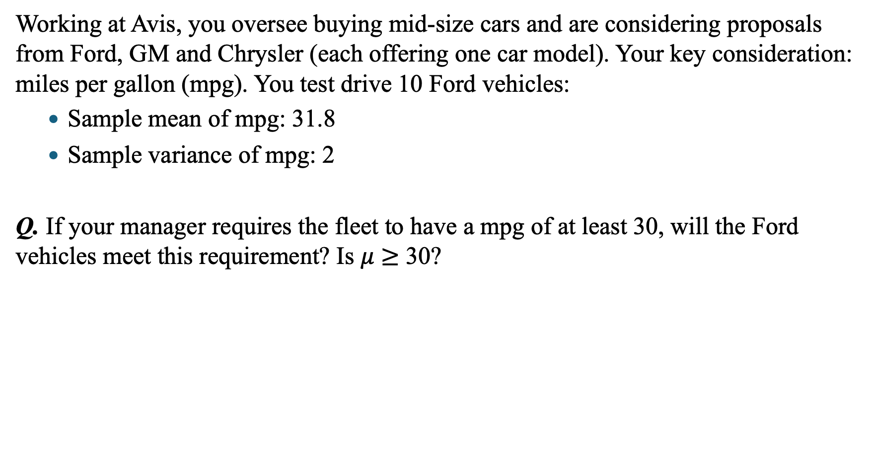
Example 2: Evaluate a Candidate of $μ$
Working at Avis, you oversee buying mid-size cars and are considering proposals from Ford, GM and Chrysler (each offering one car model). Your key consideration: miles per gallon (mpg). You test drive 10 Ford vehicles:
Sample mean of mpg: 31.8
Sample variance of mpg: 2
Q. If your manager requires the fleet to have a mpg of at least 30, will the Ford vehicles meet this requirement? Is $μ$ $≥$ 30?
$$n=10$$
$$\overline{X}=31.8$$
S $=\sqrt{2}$
S $=\sqrt{2}$
Notes:
Under varying conditions:

Slide 22
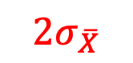
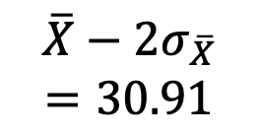
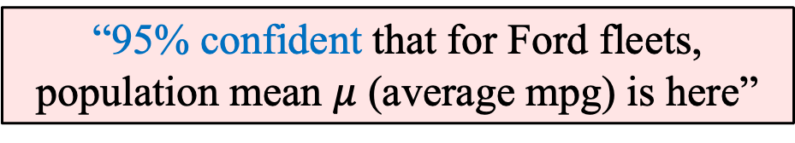

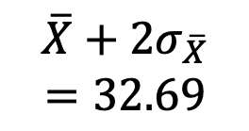
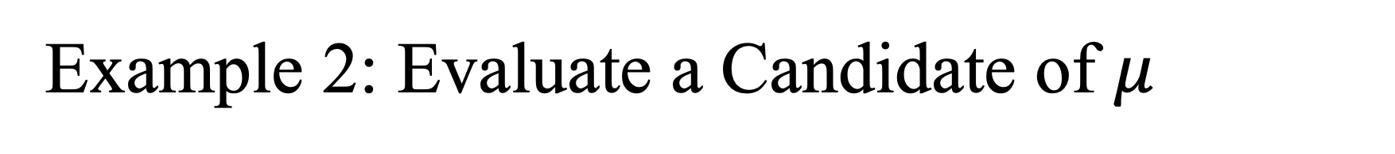


Example 2: Evaluate a Candidate of $μ$
… not exactly correct :(
“95% confident that for Ford fleets,
population mean $μ$ (average mpg) is here”
Requirement
$|30−\overline{X}$|
$$30$$
$$2σ_{\overline{X}}$$
$$\overline{X}−2σ_{\overline{X}}$$
$$=30.91$$
$$\overline{X}$$
$$=31.8$$
$$\overline{X}+2σ_{\overline{X}}$$
$$=32.69$$
Notes:
Casual Q&A:
How do you think?
Requirement is >30. we are confident that most likely mu is in this range
Then most likely, do you think a Fort fleets are likely to meet this requirement?
Student: Yes
Q: why?
Student: because the lower bound of the interval is still higher than the requirement bar.
Comment: Because …… So to formally summarize it, we can do it in two ways

Slide 23











Example 2: Evaluate a Candidate of $μ$
Q. Will the Ford vehicles meet the requirement: $μ$ $≥$ 30?
$$n=10$$
$$σ_{\overline{X}}=\frac{σ}{\sqrt{n}}$$
$$≈\frac{S}{\sqrt{n}}$$
$$=\frac{\sqrt{2}}{\sqrt{10}}=0.447$$
$$\overline{X}=31.8$$
S $=\sqrt{2}$
$$\left|30−\overline{X}\right|$$
$$=\left|30−31.8\right|$$
$$=1.8$$
$$>$$
$${2σ}_{\overline{X}}$$
Notes:
Transition to the next slide:
Why?
Because the benchmark has changed

Slide 24






Distribution of Sample Proportion ($\hat{p})$
… works exactly the same.
$$σ_{\hat{p}}=\sqrt{\frac{p(1−p)}{n}}$$
$$σ_{\hat{p}}$$
$$When sample is$$
$$large enough$$
$\hat{p}\sim N\left(μ_{\hat{p}}, { σ}_{\hat{p}}^{2} \right)=N(p,\frac{p(1−p)}{n}$)
Notes:
Translate from X to the standardized normal (the “Z” distribution) by subtracting the mean of X and dividing by its standard deviation:

Slide 25





Empirical (1-2-3) Rule for $(\hat{p}$)
68% chance of being within one standard deviation of the mean
95% chance of being within two standard deviations of the mean
$$P\left(μ_{\hat{p}}−σ_{\hat{p}}<\hat{p}<μ_{\hat{p}}+σ_{\hat{p}}\right)$$
$$=0.68$$
$$P\left(μ_{\hat{p}}−2σ_{\hat{p}}<\hat{p}<μ_{\hat{p}}+2σ_{\hat{p}}\right)$$
$$=0.95$$
Notes:
Translate from X to the standardized normal (the “Z” distribution) by subtracting the mean of X and dividing by its standard deviation:

Slide 26



Empirical (1-2-3) Rule for $(\hat{p}$)
99.7% chance of being within three standard deviation of the mean
$$P\left(μ_{\hat{p}}−3σ_{\hat{p}}<\hat{p}<μ_{\hat{p}}+3σ_{\hat{p}}\right)$$
$$=0.997$$
Notes:
Translate from X to the standardized normal (the “Z” distribution) by subtracting the mean of X and dividing by its standard deviation:

Slide 27






E$stimating a Population Proportion (\hat{p}$)
Point estimate
$\hat{p}$is the most likely value for $p$
Interval estimate
A confidence interval around $\hat{p}$where $p$ is likely to be:
= $\hat{p}±$ Critical Value $∙σ_{\hat{p}}$
$=\hat{p}±$ Critical Value $∙\sqrt{\frac{p(1−p)}{n}}$
$$=[\hat{p}− \text{Critical} \text{Value} ∙\sqrt{\frac{p(1−p)}{n}},$$
$$\hat{p}+ \text{Critical} \text{Value} ∙\sqrt{\frac{p\left(1−p\right)}{n}} ]$$
Notes:
Under varying conditions:

Slide 28













Example 3: Find the CI for $p$
Q. What is a 95% confidence interval estimate for the population proportion of social media users who have purchased an item promoted by a celebrity on a social media?
$$n=1000$$
$$\hat{p}=0.26$$
$95\%$ C.I of$p$= [?, ?]
$$σ_{\hat{p}}=\sqrt{\frac{p(1−p)}{n}}$$
$$\hat{p}±2σ_{\hat{p}}$$
$$=0.26±2×0.014$$
$$≈\sqrt{\frac{\hat{p}(1−\hat{p})}{n}}$$
$$=0.26±0.028$$
$$=[0.232,$$
$$0.288]$$
$$=\sqrt{\frac{0.26×(1−0.26)}{1000}}$$
$$=0.014$$
Notes:
Under varying conditions:

Slide 29









Example 4: Evaluate a Candidate of $p$
Q. Are you likely to purchase an item promoted by a celebrity on social media?
I$s p>0.25?$
$$n=1000$$
$$\hat{p}=0.26$$
$95\%$ C.I of$p$ = $[0.232,$ $0.288]$
$$0.25$$
$$\hat{p}−2σ_{\hat{p}}$$
$$=0.232$$
$$\hat{p} =0.26$$
$$\hat{p}+2σ_{\hat{p}}$$
$$=0.288$$
No, because the 95% interval estimate contains 0.25
Notes:
Is calculated to be equal to

Slide 30


Example 4: Evaluate a Candidate of $p$
Q. Are you likely to purchase an item promoted by a celebrity on social media?
I$s p<0.3?$
$$n=1000$$
$$\hat{p}=0.26$$
$95\%$ C.I of$p$ = $[0.232,$ $0.288]$
$$0.3$$
$$\hat{p}−2σ_{\hat{p}}$$
$$=0.232$$
$$\hat{p} =0.26$$
$$\hat{p}+2σ_{\hat{p}}$$
$$=0.288$$
Yes, because 0.3 is outside the 95% C.I. to the right
Notes:
Is calculated to be equal to

Slide 31


Hypothesis Testing
… a hypothesis is a claim (assertion) about a population parameter.
Population mean
Population proportion
The mean monthly cellphone bill in this city is
$μ=\$42$
The proportion of adults in this city with cellphones is
$p=0.68$

Slide 32


Hypothesis Testing: The Null Hypothesis ($H_{0}$)
… the baseline assumption about what is true.
Example: The mean diameter of a manufactured bolt is 30mm
$H_{0}:μ=30$

Slide 33
Hypothesis Testing: The Null Hypothesis ($H_{0}$)
… some examples.
The accused is innocent (until proven guilty)
New product is no different from old one (until proven better)
Average salary after graduation = $46,000 (until proven different)
Average wealth is at least $100,000 (until proven < $100,000)

Slide 34



Hypothesis Testing: The Null Hypothesis ($H_{0}$)
… some examples.
Null
Alternative
Null Hypothesis: $H_{0}$
Examples
$H_{0}: μ=μ_{0}$
$H_{0}: μ≥μ_{0}$
$H_{0}: μ≤μ_{0}$
Alternative Hypothesis: $H_{1}$ or $H_{A}$
Examples
$H_{A}: μ≠μ_{0}$
$H_{A}: μ<μ_{0}$
$H_{A}: μ>μ_{0}$
H_{A} is the hypothesis you are gathering evidence in support of.
$H_{0}$ is the hypothesis you would like to reject.
The idea: Reject $H_{0}$ only when there are lots of evidence against it.
A technicality: always include “ = “ in $H_{0}$ $(=, ≥, ≤)$

Slide 35

Hypothesis Testing
… how does it work in practice?
A M&M plant operation manager is looking at the efficiency of their automated production lines. According to company specification, average #(green beans) in a bag should be 4.
If population mean is not different from the desired level of 4
→ Happy for production to go on undisturbed.
If population mean is different from the desired level of 4
→ Needs to stop production and adjust the production line.
Notes:
A version of this is used a lot in internect companies
You conclude that

Slide 36



Hypothesis Testing
… how does it work in practice?
A M&M plant operation manager is looking at the efficiency of their automated production lines. According to company specification, average #(green beans) in a bag should be 4.
The population mean is 4
$H_{0}:μ=4$
$H_{A}:μ≠4$
Q. How to test the null hypothesis $H_{0}$?
Randomly sample bags.
Calculate the average number of green beans per sampled bag ($\overline{X}$).
Compare that $\overline{X}$to what you would expect if the null hypothesis was true.
Notes:
A version of this is used a lot in internect companies
You conclude that

Slide 37



Hypothesis Testing
$H_{0}:μ=4$
$$H_{A}:μ≠4$$
… how does it work in practice?
Suppose $\overline{X}=2.8,$ significantly lower than 4.
If the null hypothesis were true:
→ Prob(get such a value as the sample mean) would be very small
→ Reject the null hypothesis
In other words, if the population mean were 4:
→ Getting a sample mean 2.8 is very unlikely.
→ Conclude that the population mean $μ$must not be 4.
Notes:
A version of this is used a lot in internect companies
You conclude that

Slide 38




Hypothesis Testing
$H_{0}:μ=4$
$$H_{A}:μ≠4$$
… how does it work in practice?
… Confidence intervals!
$$\overline{X}−2σ_{\overline{X}}$$
$$\overline{X}$$
$$\overline{X}+2σ_{\overline{X}}$$
Unlikely for $μ$ to be here.
So reject the null hypothesis.
Notes:
A version of this is used a lot in internect companies
You conclude that

Slide 39





Hypothesis Testing
$H_{0}:μ=4$
$$H_{A}:μ≠4$$
… how does it work in practice?
… Confidence intervals!
Unlikely
$\overline{X}$
Suppose $H_{0}$ were true
$\overline{X}$ shouldn’t have been here
$$μ−2σ_{\overline{X}}$$
$$μ+2σ_{\overline{X}}$$
Notes:
A version of this is used a lot in internect companies
You conclude that

Slide 40






General Example
95%
Rejection Region,
Size = $2.5\%$
Rejection Region,
Size = $2.5\%$
$H_{0}:$ Pop. Mean = $μ$
$$\overline{X}$$
$$\overline{X}$$
5%
5% = Size (Red Region)
= P(Observe $\overline{X}$ in Red, when $\overline{X}$ follows this distribution with mean $μ$)
= P(Observe $\overline{X}$ in Red, given that $H_{0}$ is true)
= P(Observe $\overline{X}$ in Red | $H_{0}$ is true)
= P($\overline{X}$ is too “extreme” to occur | $H_{0}$ is true)
= P(We find evidence to reject $H_{0}$ | $H_{0}$ is true)
= P(Observe $\overline{X}$ in Rejection Region | $H_{0}$ is true)

Slide 41








More General Example
$$1−α$$
Rejection Region,
Size = $α/2$
Rejection Region,
Size = $α/2$
$$\overline{X}$$
$$\overline{X}$$
$$α$$
$H_{0}:$ pop. mean = $μ$
$α$ = P(Observe $\overline{X}$ in Rejection Region | $H_{0}$ is true)
= P(Reject $H_{0}$ | $H_{0}$ is true)
= P(Incorrectly rejecting $H_{0} aka$ Type I error)
= Significance level of the hypothesis test
A situation that we dislike

Slide 42

More General Example
$$1−α$$
Rejection Region,
Size = $α/2$
Rejection Region,
Size = $α/2$
$$\overline{X}$$
$$\overline{X}$$
$$α$$
$1−α$ = P(observe $\overline{X}$ outside the Rejection Region | $H_{0}$ is true)
$H_{0}:$ pop. mean = $μ$
= P(do not reject $H_{0}$ | $H_{0}$ is true)
= P(do not having a false alarm)
= confidence level of the hypothesis test
$$1−α=68\%$$
$$1−α=95\%$$
$$1−α=99.7\%$$
A situation that we like

Slide 43










Language
$$1−α$$
Rejection Region,
Size = $α/2$
Rejection Region,
Size = $α/2$
$H_{0}:$ pop. mean = $μ$
$$\overline{X}$$
$$\overline{X}$$
$$α$$
If $\overline{X}$ falls in the rejection region, we can reject $H_{0}$ with $100∙\left(1−α\right)\%$ confidence.
$$α=0.32, …. 68\% confidence$$
$$α=0.05, …. 95\% confidence$$
$$α=0.003, …. 99.7\% confidence$$
If $\overline{X}$ falls outside the rejection region, $H_{0}$ can’t be rejected with $100∙\left(1−α\right)\%$ confidence.

Slide 44




The Intuition
$$1−α$$
Rejection Region,
Size = $α/2$
Rejection Region,
Size = $α/2$
If $\overline{X}$ is close to the stated $μ, H_{0}$is not rejected.
If $\overline{X}$ is far away from the stated $μ$, $H_{0}$is rejected.
→ How far is “far enough” to reject $H_{0}$?
Notes:
It divides the rejection and nonrejection regions
It creates a “line in the sand” for decision making

Slide 45
How Far Is Far Enough?
Critical Value Approach
p-Value Approach
Notes:
It divides the rejection and nonrejection regions
It creates a “line in the sand” for decision making

Slide 46



Example 1: Critical Value Approach
… in 5 steps.
Set $H_{0}$ and $H_{A}$.
Identify significant level $α$ and sample size n.
Use $α$ to determine the critical values that divide the rejection and nonrejection regions.
Compute the test statistic (Z value).
Conclude:
→ $\overline{X}$ in the rejection region →
→ $\overline{X}$ in the nonrejection region →
If |test statistic| > |critical value|
Reject $H_{0}$
If |test statistic| < |critical value|
Can’t reject $H_{0}$
Notes:
It divides the rejection and nonrejection regions
It creates a “line in the sand” for decision making

Slide 47


Example 1: Critical Value Approach
Hawaii Tourism Authority had estimated that the average stay of Pro Bowl visitors is 10.1 days.
In 2003, they surveyed 260 Pro Bowl visitors, with an average stay of 9.1 days, and a standard deviation of 5.7 days.
Q. Can you reject their claim with 95% confidence?
$H_{0}:μ=10.1$
$H_{A}:μ≠10.1$
Notes:
It divides the rejection and nonrejection regions
It creates a “line in the sand” for decision making

Slide 48













Example 1: Critical Value Approach (95%)
For $α=0.05$, the critical values are $±2$.
Compute the test statistics (Z value of $\overline{X}$):
Compare test statistics and critical value:
Can reject the null hypothesis with 95% confidence.
$H_{0}:μ=10.1$
$H_{A}:μ≠10.1$
$$\overline{X}=9.1$$
$$S=5.7$$
$$α=0.05$$
$$n=260$$
$$σ_{\overline{X}}=\frac{σ}{\sqrt{n}}$$
$$Z=\frac{\overline{X}−μ_{\overline{X}}}{σ_{\overline{X}}}=\frac{\overline{X}−μ }{σ_{\overline{X}}}$$
$$=\frac{9.1−10.1}{0.35}$$
$$≈\frac{S}{\sqrt{n}}$$
$$=−2.86$$
$$=\frac{5.7}{\sqrt{260}}$$
$$\left|Z\right|=2.86>\left|Critical Value\right|=2$$
$$=0.35$$
Notes:
It divides the rejection and nonrejection regions
It creates a “line in the sand” for decision making

Slide 49


Example 1: Critical Value Approach (99.7%)
For $α=0.003$, the critical values are $±3$.
Compute the test statistics (Z value of $\overline{X}$):
Compare test statistics and critical value:
Cannot reject the null hypothesis with 99.7% confidence.
$H_{0}:μ=10.1$
$H_{A}:μ≠10.1$
$$\overline{X}=9.1$$
$$S=5.7$$
$$α=0.003$$
$$n=260$$
$$σ_{\overline{X}}=\frac{σ}{\sqrt{n}}$$
$$Z=\frac{\overline{X}−μ_{\overline{X}}}{σ_{\overline{X}}}=\frac{\overline{X}−μ }{σ_{\overline{X}}}$$
$$=\frac{9.1−10.1}{0.35}$$
$$≈\frac{S}{\sqrt{n}}$$
$$=−2.86$$
$$=\frac{5.7}{\sqrt{260}}$$
$$\left|Z\right|=2.86<\left|Critical Value\right|=3$$
$$=0.35$$
Notes:
It divides the rejection and nonrejection regions
It creates a “line in the sand” for decision making

Slide 50

Example 1: Critical Value Approach (99.7%)
If $\overline{X}=8.6$, what do you think of the Hawaii Tourism Authority’ s claim?
Notes:
It divides the rejection and nonrejection regions
It creates a “line in the sand” for decision making
In the future:
Make this an in-class practice, then use Q&As to pool the results Q&A1: Z=?
Q&A2: critical value to compare with?
If adopt this change, then move p-value entirely to next class

Slide 51

Observation
If we can reject $H_{0}$ at a certain confidence level,
then we can reject $H_{0}$ at any confidence level lower than that.
The opposite does not hold.
Why? Can you show it in the graph?
Notes:
Better to be (slightly) overqualified
than to be underqualified

Slide 52

Useful Facts: Hypothesis Testing
We need a sample mean and standard deviation of the sample mean.
We construct a null and alternative hypothesis:
$H_{0}: μ=μ_{0}$ vs. $H_{A}: μ≠μ_{0}$
Using the critical value approach:
If |test statistic $Z=\frac{\overline{X}−μ }{σ_{\overline{X}}}$| > |critical value| → Reject $H_{0}$
If |test statistic $Z=\frac{\overline{X}−μ }{σ_{\overline{X}}}$| $≤$ |critical value| → Can’t reject $H_{0}$

Slide 53







p-Value Approach to Testing
P(observe a more extreme value than $\overline{X }| H_{0}$ is true)
= $p$-value
$$−\overline{X}$$
$$\overline{X}$$
$$CV=±1 or±2 or±3$$
(vs. Z-value of $\overline{X})$
P(fall in rejection region)
= P(fall in either tail)
= $α$
Notes:
It divides the rejection and nonrejection regions
It creates a “line in the sand” for decision making

Slide 54


p-Value Approach to Testing
$p$-value =
Size of
Blue Region
$$−\overline{X}$$
$$\overline{X}$$
$$CV=±1 or±2 or±3$$
(vs. Z-value of $\overline{X})$
$α$=
Size of
Red Region
Notes:
It divides the rejection and nonrejection regions
It creates a “line in the sand” for decision making

Slide 55










p-Value Approach to Testing
Case 1:
if $p$-value < $α$,
→ $\overline{X}$ is in rejection region
→ Reject $H_{0}$
$p$-value =
Blue Region
at significance level $α$
$$\overline{X}$$
μ
$$−\overline{X}$$
$$\overline{X}$$
(confidence level $1−α$)
$α$=
Red Region
Case 2:
if $p$-value $≥α$,
→ $\overline{X}$ is in nonrejection region
→ Can’t reject $H_{0}$
$$−\overline{X}$$
$$\overline{X}$$
Notes:
It divides the rejection and nonrejection regions
It creates a “line in the sand” for decision making

Slide 56








Critical Value vs p-Value
Critical value approach:
Compare numbers
p-value approach:
Compare probabilities
Test statistic ($Z$-value of $\overline{X}$)
vs. CV at $±1 or±2 or±3$
$p$-value (size of blue region)
vs. $α$ (size of red region)
μ
$$\overline{X}$$
$$\overline{X}$$
$$\overline{X}$$
$$\overline{X}$$
$$\overline{X}$$
Notes:
It divides the rejection and nonrejection regions
It creates a “line in the sand” for decision making

Slide 57





p-Value Approach to Testing
… in 4 steps.
Set $H_{0}$ and $H_{A}$
Identify significant level $α$ and sample size n
Compute the test statistic (z value) and p-value
Conclude:
→ $\overline{X}$ in the rejection region
→
→ $\overline{X}$ in the nonrejection region
→
If p-value < $α$
Reject $H_{0}$
If p-value $≥$ $α$
Can’t reject $H_{0}$
Notes:
It divides the rejection and nonrejection regions
It creates a “line in the sand” for decision making

Slide 58
Example 2: p-Value Approach
Hawaii Tourism Authority had estimated that the average stay of Pro Bowl visitors is 10.1 days.
In 2003, they surveyed 260 Pro Bowl visitors, with an average stay of 9.1 days, and a standard deviation of 5.7 days.
Q. Can you reject their claim with 95% confidence?
$H_{0}:μ=10.1$
$H_{A}:μ≠10.1$
Notes:
It divides the rejection and nonrejection regions
It creates a “line in the sand” for decision making

Slide 59

Example 2: p-Value Approach
For $α=0.05$, the critical values are $±2$.
Compute the test statistics (Z value of $\overline{X}$):
and the p-value.
$H_{0}:μ=10.1$
$H_{A}:μ≠10.1$
$$\overline{X}=9.1$$
$$S=5.7$$
$$α=0.05$$
$$n=260$$
$$σ_{\overline{X}}=\frac{σ}{\sqrt{n}}$$
$$Z=\frac{\overline{X}−μ_{\overline{X}}}{σ_{\overline{X}}}=\frac{\overline{X}−μ }{σ_{\overline{X}}}$$
$$=\frac{9.1−10.1}{0.35}$$
$$≈\frac{S}{\sqrt{n}}$$
$$=−2.86$$
$$=\frac{5.7}{\sqrt{260}}$$
$$=0.35$$
Notes:
It divides the rejection and nonrejection regions
It creates a “line in the sand” for decision making

Slide 60

Example 2: p-Value Approach
Q. Which region represents the p-value of the test statistic -2.86?
(A) Region 1
(B) Region 4
(C) Region 1 + Region 4
(D) Region 2 + Region 3
Notes:
It divides the rejection and nonrejection regions
It creates a “line in the sand” for decision making

Slide 61
Example 2: p-Value Approach
Q. Which region represents the p-value of the test statistic -2.86?
(A) Region 1
(B) Region 4
(C) Region 1 + Region 4 = 2 ×Region 1 = 2 ×P(Z < -2.86)
(D) Region 2 + Region 3
Notes:
It divides the rejection and nonrejection regions
It creates a “line in the sand” for decision making

Slide 62
Example 2: p-Value Approach
Q. Use python to find P(Z < -2.86).
Notes:
Jiang:
This slide involves two things:
Use excel to find P(X<a)
Use the distribution table to find P(X<a)
Maybe should email class to be present on Wednesday, because they don’t want to miss it. Because we will learn how to use the table tofind P(X<a), which will be on the exam. And also, because there will be an early-Halloween survey that they don’t want to miss

Slide 63

Example 2: p-Value Approach
For $α=0.05$, the critical values are $±2$.
Compute the test statistics (Z value of $\overline{X}$):
and the p-value.
Compare the test statistics and $α$:
p-value = 2 × P(Z < -2.86) = 2 × $0.002$
= 0.004 < $α=0.05$
Can reject the null hypothesis with 95% confidence
$H_{0}:μ=10.1$
$H_{A}:μ≠10.1$
$$\overline{X}=9.1$$
$$S=5.7$$
$$α=0.05$$
$$n=260$$
$$σ_{\overline{X}}=\frac{σ}{\sqrt{n}}$$
$$Z=\frac{\overline{X}−μ_{\overline{X}}}{σ_{\overline{X}}}=\frac{\overline{X}−μ }{σ_{\overline{X}}}$$
$$=\frac{9.1−10.1}{0.35}$$
$$≈\frac{S}{\sqrt{n}}$$
$$=−2.86$$
$$=\frac{5.7}{\sqrt{260}}$$
$$=0.35$$
Notes:
It divides the rejection and nonrejection regions
It creates a “line in the sand” for decision making

Slide 64




How to Conclude
$H_{0}:μ=10.1$
$H_{A}:μ≠10.1$
Statistical conclusion:
Can’t reject $H_{0}$ with 95% confidence.
Can’t reject $H_{0}$.
Practical conclusion:
Can’t reject the hypothesis that the average stay is 10.1 days
The average stay is not significantly different from 10.1 days
$$All statements work!$$
Notes:
It divides the rejection and nonrejection regions
It creates a “line in the sand” for decision making

Slide 65

Useful Facts: Hypothesis Testing
We need a sample mean and standard deviation of the sample mean.
We construct a null and alternative hypothesis:
$H_{0}: μ=μ_{0}$ vs. $H_{A}: μ≠μ_{0}$
Using the critical value approach:
If |test statistic $Z=\frac{\overline{X}−μ }{σ_{\overline{X}}}$| > |critical value| → Reject $H_{0}$
If |test statistic $Z=\frac{\overline{X}−μ }{σ_{\overline{X}}}$| $≤$ |critical value| → Can’t reject $H_{0}$
Using the p-value approach:
If p-value < $α$ → Reject $H_{0}$
If p-value $≥$ $α$ → Can’t reject $H_{0}$

Slide 66
Example 2: p-Value Approach
For $α=0.05$, the critical values are $±2$.
Compute the test statistics (Z value of $\overline{X}$):
and the p-value.
Compare the test statistics and $α$:
p-value = 2 × P(Z < -2.86) = 2 × $0.002$
= 0.004 < $α=0.05$
Can reject the null hypothesis with 95% confidence
$H_{0}:μ=10.1$
$H_{A}:μ≠10.1$
$$\overline{X}=9.1$$
$$S=5.7$$
$$α=0.05$$
$$n=260$$
$$σ_{\overline{X}}=\frac{σ}{\sqrt{n}}$$
$$Z=\frac{\overline{X}−μ_{\overline{X}}}{σ_{\overline{X}}}=\frac{\overline{X}−μ }{σ_{\overline{X}}}$$
$$=\frac{9.1−10.1}{0.35}$$
$$≈\frac{S}{\sqrt{n}}$$
$$=−2.86$$
$$=\frac{5.7}{\sqrt{260}}$$
$$=0.35$$
Notes:
It divides the rejection and nonrejection regions
It creates a “line in the sand” for decision making

Slide 67




Example 2: p-Value Approach (extension)
For $α=0.05$, the critical values are $±2$.
Compute the test statistics (Z value of $\overline{X}$):
and the p-value.
Compare the test statistics and $α$:
p-value = 2 × P(Z > 1.14) = 2 × $\left(1−0.87\right)=\text{2} \text{×} 0.13$
= 0.26 > $α=0.05$
Cannot reject the null hypothesis with 95% confidence
$H_{0}:μ=10.1$
$H_{A}:μ≠10.1$
$$\overline{X}=10.5$$
$$S=5.7$$
$$α=0.05$$
$$n=260$$
$$σ_{\overline{X}}=\frac{σ}{\sqrt{n}}$$
$$Z=\frac{\overline{X}−μ_{\overline{X}}}{σ_{\overline{X}}}=\frac{\overline{X}−μ }{σ_{\overline{X}}}$$
$$=\frac{10.5−10.1}{0.35}$$
$$≈\frac{S}{\sqrt{n}}$$
$$=1.14$$
$$=\frac{5.7}{\sqrt{260}}$$
$$=0.35$$
Notes:
It divides the rejection and nonrejection regions
It creates a “line in the sand” for decision making

Slide 68




Rule of Thumb in Practice
Most Commonly Used confidence level
Most Commonly Used significance level
Reject the null ${(H}_{0})$ in favor of $H_{A}$ if
$$1−α=95\%$$
$$α=0.05$$
$p$-value <$α=0.05$
Notes:
Better to be (slightly) overqualified
than to be underqualified

Slide 69

p-Value: What it is and what it is not
One rejects the null hypothesis $H_{0}$when
$$Prob\left( \begin{matrix}\begin{aligned}Sampling data is more extreme \\ than the data you have observed\end{aligned} & | & \begin{aligned}H_{0} \\ is true\end{aligned}\end{matrix} \right)≤α$$
This is not
$$Prob\left( \begin{matrix}\begin{aligned}Null hypothesis H_{0} \\ is true\end{aligned} & | & \begin{aligned}Observed \\ data\end{aligned} \end{matrix} \right)≤α$$
We cannot interpret the p-value as the probability that the Null Hypothesis is true given our data!
Hypothesis Testing
Confidence Interval

